Slide 1
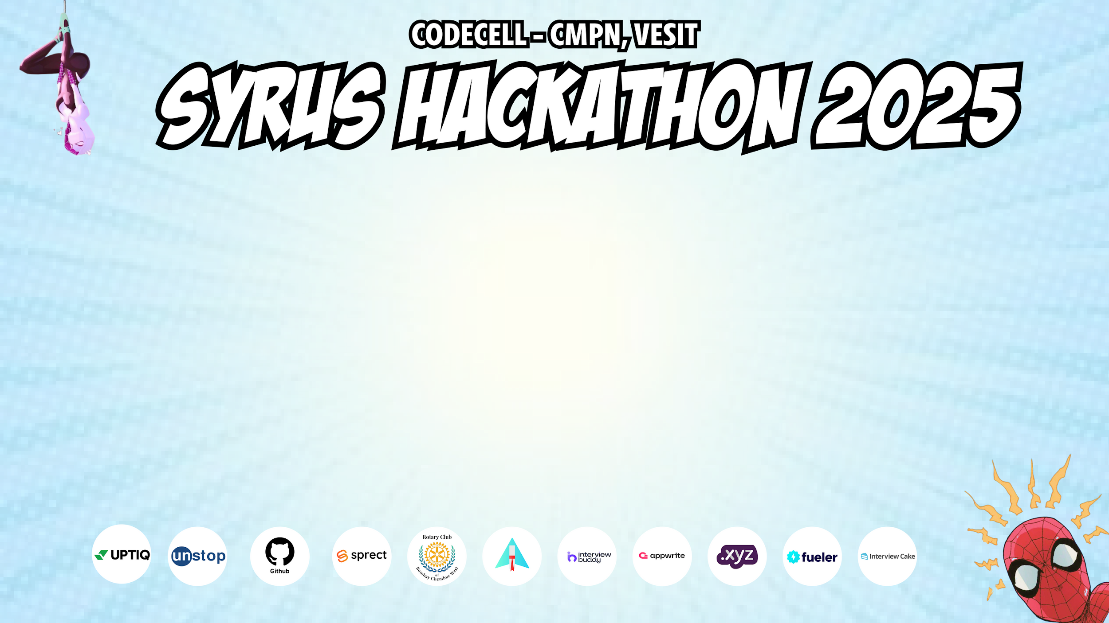
Category Code : C1
Problem Statement Title : MentorNet - AI-Powered Web3 Decentralized Mentorship Platform.
Team Name : Arjun[D]
Institute Name : Vivekanand Education Society’s Institute of Technology

Slide 2
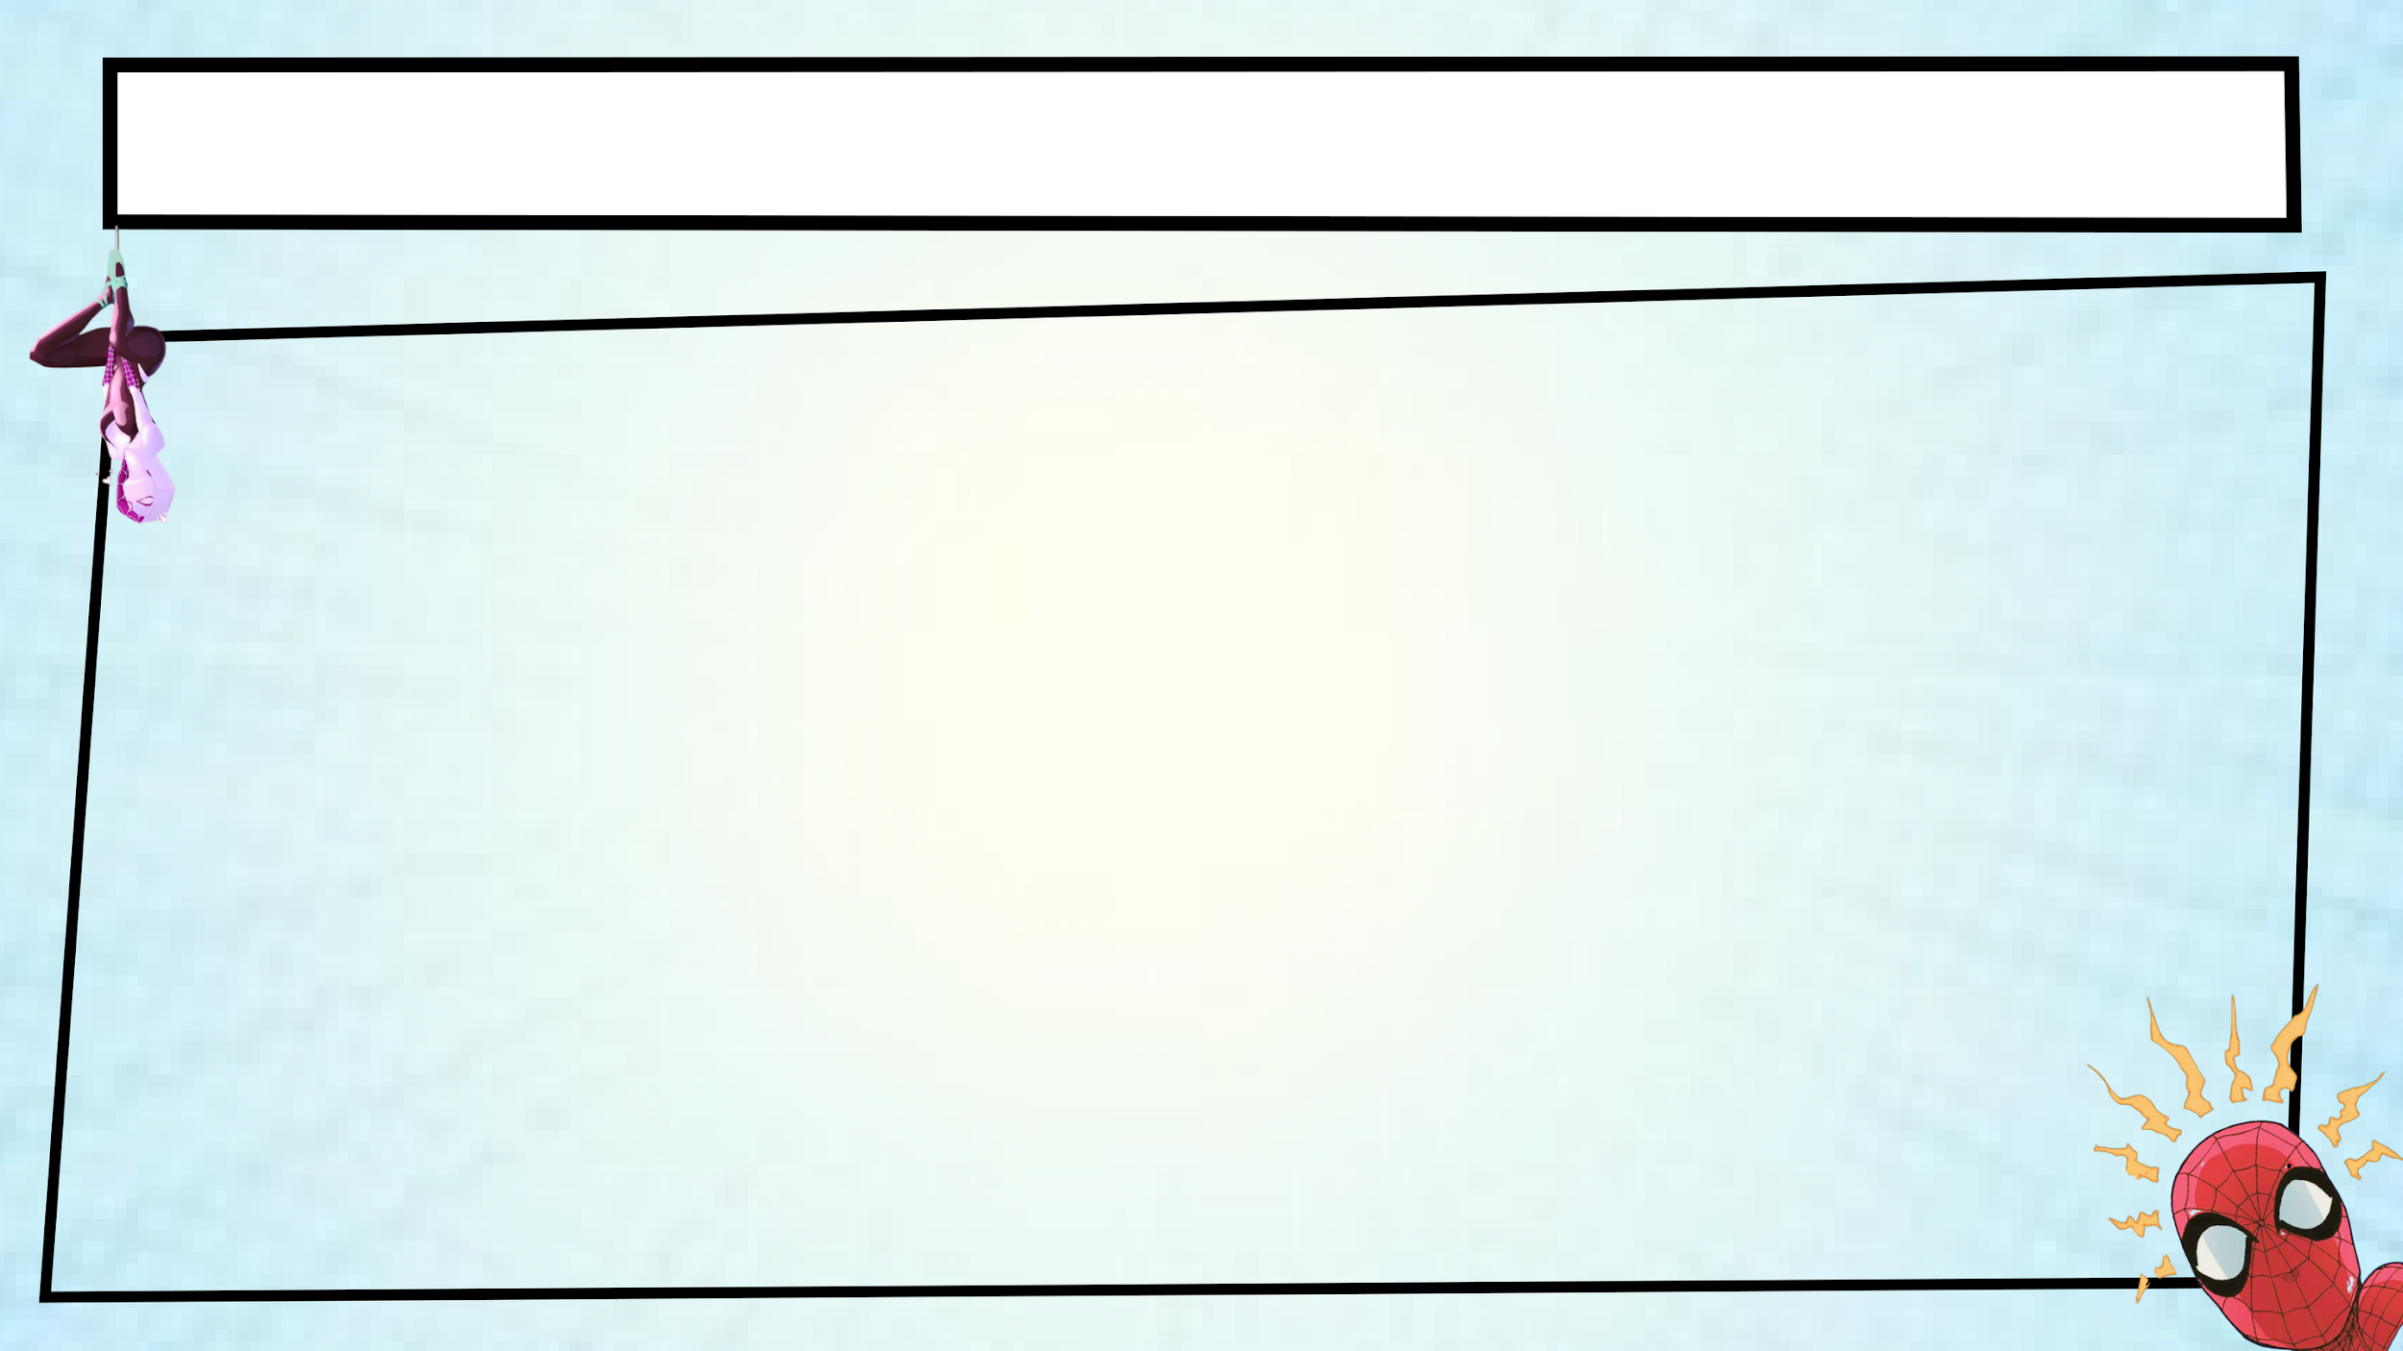
Problem Statement
Millions of talented students face a challenge every year in finding the right mentorship, career guidance, and credible skill certification. The barriers are real and frustrating -
Geographic Limitations : Many students are deprived of access to experienced mentors due to their place of residence.
Financial Constraints : Mentorship of high quality and career coaching are usually expensive and unaffordable.
Limited Networking Opportunities : Breaking into competitive industries can feel impossible without the right connections.
Standardized Learning Paths : The generic approach to education does not cater to individual strengths and interests.
Skills Without Verification : Conventional certificates are easily forged, so it's hard to prove real expertise.
The world requires a new method. A mentorship platform which is decentralized AI driven, and built to provide students with real opportunities, regardless of their background.

Slide 3
Idea / Approach Details
MentorNet is a decentralized AI-powered mentorship platform designed to provide accessible transparent and personalized career guidance. By leveraging blockchain and AI, it eliminates geographical and economic barriers, ensuring students connect with verified mentors globally.
Platform AI matchmaking is based on student skills goals, industry trends to recommend mentors, ensuring relevant guidance. Blockchain-based certification ensures skill authenticity using Soulbound Tokens (SBTs), preventing fraud, enhancing credibility.
MentorNet introduces tokenized incentives. This rewards mentors with crypto tokens. Students can also earn tokens through skill-based achievements. MentorNet fosters an inclusive mentorship ecosystem by integrating trust, personalization, and rewards. This ecosystem is future-ready.

Slide 4
Real World Impact
MentorNet isn’t just about individual success but it supports broader global sustainable development goals too.
It aligns with mainly three goals, these are :
SDG 4 – Quality Education :
Making career mentorship and skills development accessible to all.
SDG 8 – Decent Work & Economic Growth :
Helping students and job seekers transition smoothly into the workforce.
SDG 9 – Industry, Innovation & Infrastructure :
Using cutting-edge technologies to improve learning and career outcomes.

Slide 5
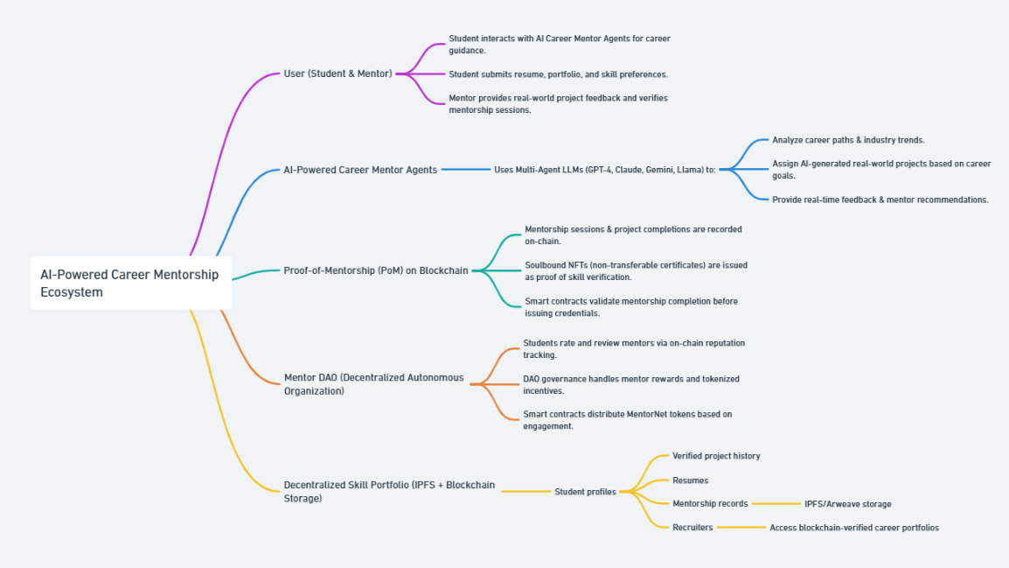
Project Workflow Diagram

Slide 6
Project Workflow Explanation
User (Student & Mentor) Actions -
Student Actions :
Engages with mentor agents powered by AI for career guidance that is personalized.
Submits resume, portfolio, and skill preferences.
Receives real-world project assignments based on career goals.
Mentor Actions :
Provides real-time feedback on student projects.
Confirms mentorship sessions and project completions.
AI-Powered Career Mentor Agents -
LLM Stack Used :
Utilizes Multi-Agent LLMs (GPT-4, Claude, Gemini
Career path analysis and industry trend insights.
Real-world project generation that is tailored to skill growth.
Dynamic feedback and mentor recommendations.

Slide 7
Project Workflow Explanation
Mentorship Sessions Recorded On-Chain -
Records the completion of projects and mentorship sessions within the blockchain.
Soulbound NFT Certificates -
Issues non-transferable verifiable certificates upon completion.
Serves as permanent evidence of skills and achievements.
Smart Contract Validation -
Checks mentorship completion prior to awarding credentials.
Ensures tamper-proof certification and integrity.
On-Chain Reputation System -
Students rate and review mentors based on performance.
Ratings are kept on-chain for tracking of reputation.
Incentive & Reward Distribution -
DAO handles mentor rewards and tokenized incentives & Smart contracts distribute MentorNet tokens based on engagement.

Slide 8
Implemented Features
User Dashboard – Next.js 15
Why We Implemented It?
To provide an intuitive and responsive interface for students and mentors.
Guarantees easy navigation and real-time updates on project status.
Next.js 15 provides optimized rendering and server-side capabilities.
Improves performance and reduces load times.
How We Implemented It?
Tech Stack :
Next.js 15 + React 19 - For a dynamic UI based on components.
Tailwind CSS + shadcn/ui - For consistent styling and responsiveness.
Motion Framer - For smooth animations and transitions.

Slide 9
Implemented Features
Smart Contract Deployment in Solidity on Polygon (Amoy) Testnet
Why We Implemented It?
To secure and immutable record-keeping of mentorship sessions.
Prevents data manipulation or forgery.
Polygon (Amoy) testnet provides cost-effective, scalable transactions.
Great for testing and deploying without the high gas prices.
How We Implemented It?
Tech Stack :
Solidity - Smart contract programming language.
Polygon (Amoy) Testnet - For test deployments and validation.

Slide 10
Implemented Features
Mentor Authentication with Wallet Connection
Why We Implemented It?
To prevent fake or duplicate mentor profiles.
Verifies authenticity using blockchain wallets.
Ensures secure access and validation of mentors.
Reduces centralized control risks.
How We Implemented It?
Tech Stack :
Wagmi + RainbowKit - For seamless wallet connection and authentication.
Supports MetaMask, Coinbase, and Wallet Connect.

Slide 11
Implemented Features
Decentralized Career Portfolio – IPFS + Blockchain
Why We Implemented It?
For storing verified mentorship data and certificates.
Ensures authentic and immutable career records.
IPFS provides permanent storage that is resistant to censorship.
Blockchain verification serves to increase the credibility and trust.
How We Implemented It?
Tech Stack :
IPFS and Arweave are ideal for decentralized portfolio storage.
Blockchain - For the verification of portfolio data on-chain.

Slide 12
Implemented Features
Learning Center
Why We Implemented It?
To enable students to track their learning journeys.
Visual progress indicators are available for courses and mentorship sessions.
How It Works?
Dynamic Course Progress
Displays percentage progress and milestones.
Tracks skill advancement and project completion.
Mentor Feedback
Improves learning outcomes with guided mentorship.
Real-time feedback loop from mentors.
Blockchain-Powered Career Portfolio & AI Mentor Page.

Slide 13
Implemented Features
Marketplace for Courses, Mentorships & Skill NFTs
Why We Implemented It?
To create a decentralized learning economy.
Gives students access to specialized courses and mentorships.
Allows mentors to monetize their expertise.
How It Works?
Courses & Mentorships
Mentors list courses & mentorship sessions.
Students purchase using platform tokens.
Courses that include skill-based projects that are verified on-chain.
Skill NFTs
NFT-based certificates are issued upon course completion.
Acts as verifiable proof of acquired skills.
Stored on IPFS and verified on the blockchain.

Slide 14
Implemented Features
AI Mentor Page – Personalized Guidance
Why We Implemented It?
To offer real-time, topic-specific guidance.
Provides tailored mentorship experiences.
How It Works?
AI-Powered Recommendations.
Uses LLMs (GPT-4, Claude, Gemini) to :
Offer guidance on skills, courses, and projects.
Suggest career paths based on student profiles.
Topic-Specific Mentorship :
Students can ask specific questions and get detailed AI responses.
Provides learning resources and industry insights.
Real-Time Insights :
Analyzing market trends and suggesting relevant skills.

Slide 15
Innovation (Showstopper)
AI-Driven Mentorship
Large Language Models (LLMs) :
Employs cutting-edge AI models to offer personalized career advice. The advice is based on an individual's skills, interests, and goals.
Provides real-time insights into emerging industry trends.
Skill Gap Analysis & Adaptive Learning Paths :
Recognizes skill deficiencies through dynamic assessments.
Recommends adaptive learning paths with targeted resources to bridge gaps.
Proposes relevant projects and courses to ensure continuous growth.
AI-Generated Real-World Projects with Feedback Loops :
Creates industry-specific projects automatically based on the user's skills.
Mentors give constructive feedback on project submissions.
Feedback fine-tunes the learning process and helps the student to develop practical skills.

Slide 16
Innovation (Showstopper)
Decentralized Platform
Web3 Architecture with Mentor DAO :
The platform is based on a decentralized architecture, which excludes dependence on central authorities.
Operates a Mentor DAO for governance.
DAO Mentors vote on proposals, ensuring community-driven decisions.
Token-Based Incentive Mechanism :
Mentors get rewarded in tokens for their contributions.
Tokens are given out according to project validation quality and student reviews.
Creates a fair and transparent reward system.
Immutable and Transparent Interactions :
All mentor-student interactions are stored on the blockchain.
Ensures transparency and authenticity of project assignments, reviews, and certifications.

Slide 17
Innovation (Showstopper)
Blockchain-Based Certification
Verifiable Skill Credentials :
Certifications are saved on the blockchain as Soulbound NFTs.
Provides tamper-proof proof of skill acquisition.
Allows employers to verify skills instantly.
Transparent Tracking of Milestones :
Each project completion is timestamped and stored immutably.
Monitors the learning path, comprising assignments, checkpoints, and competency confirmations.
Demonstrates consistent progress with clear evidence.
Enhanced Credibility and Security :
Credentials that are backed by blockchain are immutable and secure.
Adds credibility to student profiles with transparent, verifiable achievements.
Guarding against deceitful claims and counterfeit certifications.

Slide 18
Innovation (Showstopper)
Soulbound Token Integration
NFT-Based, Non-Transferable Credentials :
Issues Soulbound NFTs as skill certifications.
NFTs are unique to each user and are not transferable.
Ensures authentic proof of achievements.
Verifiable and Trustworthy Skills :
Provides indisputable proof of skill verification.
Employers and platforms can validate skills without intermediaries.
Boosts student credibility in the job market.
Promotes Trust and Integrity :
Preventing credential fraud is done by making the tokens non-transferable.
Verifies mentorship quality through on-chain records.
Builds trust and reliability in the ecosystem.

Slide 19
Tech Stack For Frontend
Next.js 15 :
Server-side rendering (SSR) for better performance and SEO.
Supports app router with layouts and nested routes.
React 19 :
Component-Based Architecture for Modular and Reusable UI.
It uses hooks and concurrent rendering for efficient state management.
Tailwind CSS
Utility-first CSS framework for faster styling.
Guarantees uniform design with predetermined classes.
shadcn/ui
Pre-styled and customizable components.
Ensuring consistent UI elements with less boilerplate code.
Framer Motion
Smooth animations for better user experience.
Utilized for interactive transitions and micro-interactions.

Slide 20
Tech Stack For Backend
Next.js API Routes :
Permits server-side logic directly in the Next.js framework.
Handles authentication, data processing, and API integration.
Supabase (PostgreSQL) :
Open-source PostgreSQL-based backend.
Manages user authentication, data storage, and queries.
Real-time syncing for instant project status updates.
Prisma ORM :
Modern Object-Relational Mapper for PostgreSQL.
Provides type-safe database interactions.
Simplifies CRUD operations with auto-generated queries.

Slide 21
Tech Stack For Blockchain
Solidity :
Smart contract programming language.
Mentor registration project validation and NFT minting were used to build.
Hardhat :
Ethereum development environment.
For smart contract compilation deployment and testing.
Alchemy :
Web3 infrastructure provider.
Provides fast and reliable access to the blockchain.
Pinata (IPFS) :
Distributed file storage system.
Stores submissions and metadata of certifications in a secure manner.
OpenZeppelin :
Pre-built contracts and libraries for NFT and token standards.
Guarantees safe and standardized smart contract development.

Slide 22
Tech Stack For DevOps & Deployment
Vercel :
Cloud platform for deploying the frontend.
Supports Next.js hosting with auto-deployment.
Provides global CDN for faster loading.
Docker :
Containerised the backend and blockchain services.
Ensures consistent environments across development and production.
Amazon EC2 :
Scalable cloud computing service.
Used for deploying and managing backend APIs.
Ensures reliable performance and scalability.

Slide 23
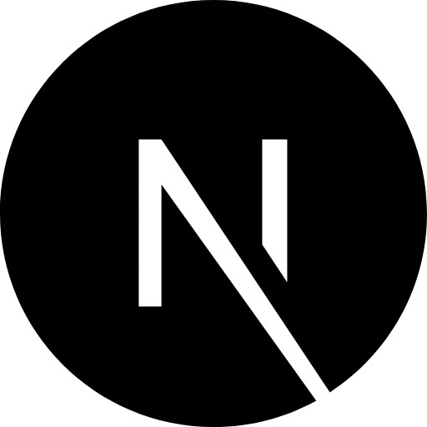
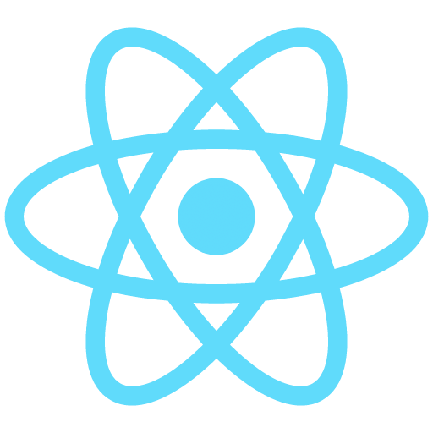


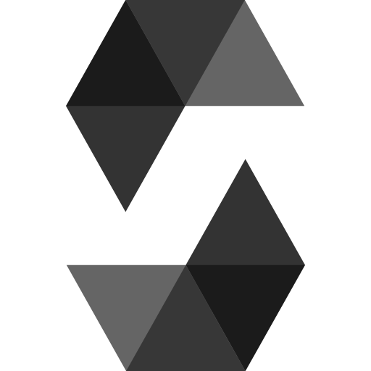

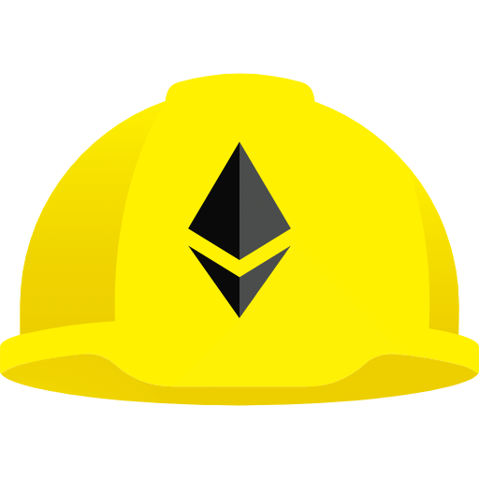



Tech Stack Summary
Category | Tech Used
Frontend | Next.js 15, React 19, Tailwind CSS, shadcn/ui, Framer Motion.
Backend | Next.js Api Routes, Supabases [PostgreSQL] , Prisma Orm.
Blockchain | Solidity, Hardhat, Alchemy, Pinata (IPFS) & OpenZeppelin.
DevOps & Deployment | Vercel, Docker, Amazon EC2.

Slide 24
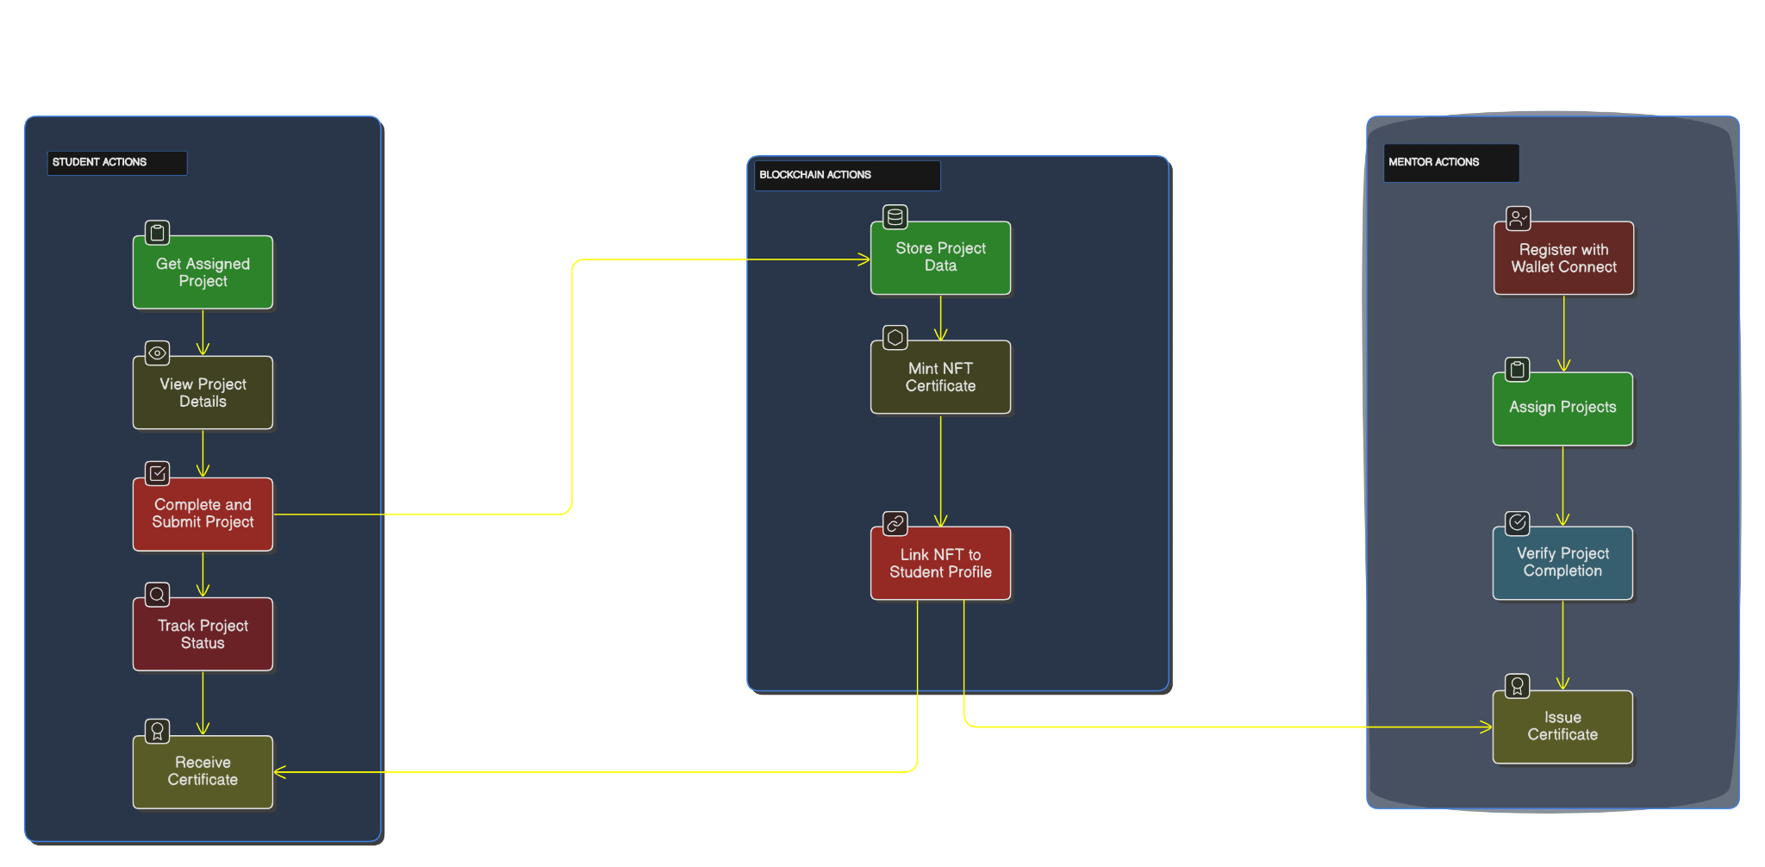
Use Case Diagram
MENTOR.NET FLOW

Slide 25
Feedback Received
Add Video Lectures for Courses :
Video lectures can be uploaded by the mentors in the course.
It provides comprehensive learning materials in addition to mentorship sessions.
Certification Evaluation with Assignments :
Certificates will not be issued based on project completion only.
Incorporated assignments as a criterion of evaluation, guaranteeing a comprehensive skills assessment.
Anti-Skip Video Tracking :
Implemented function to prevent fake video completion.
A video that is skipped to the end will not be marked as completed.
Guarantees genuine lecture involvement before moving on.

Slide 26
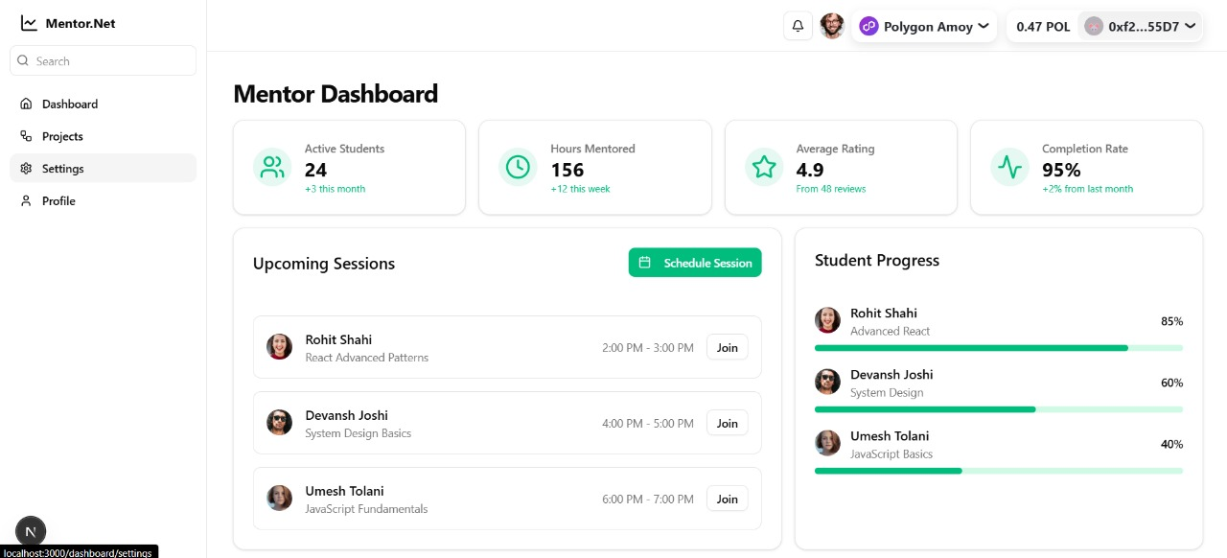
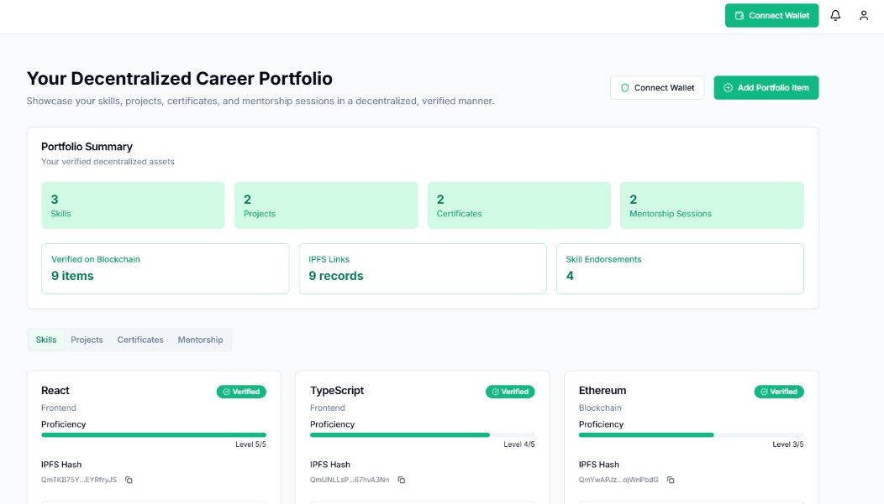
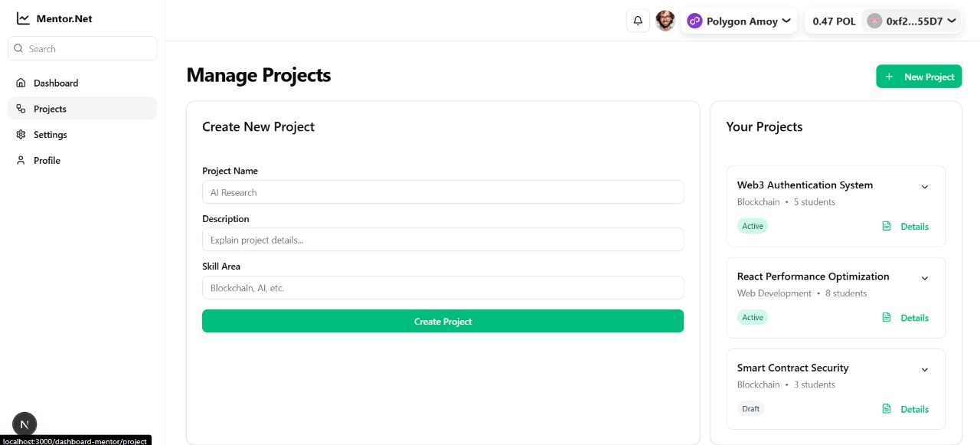
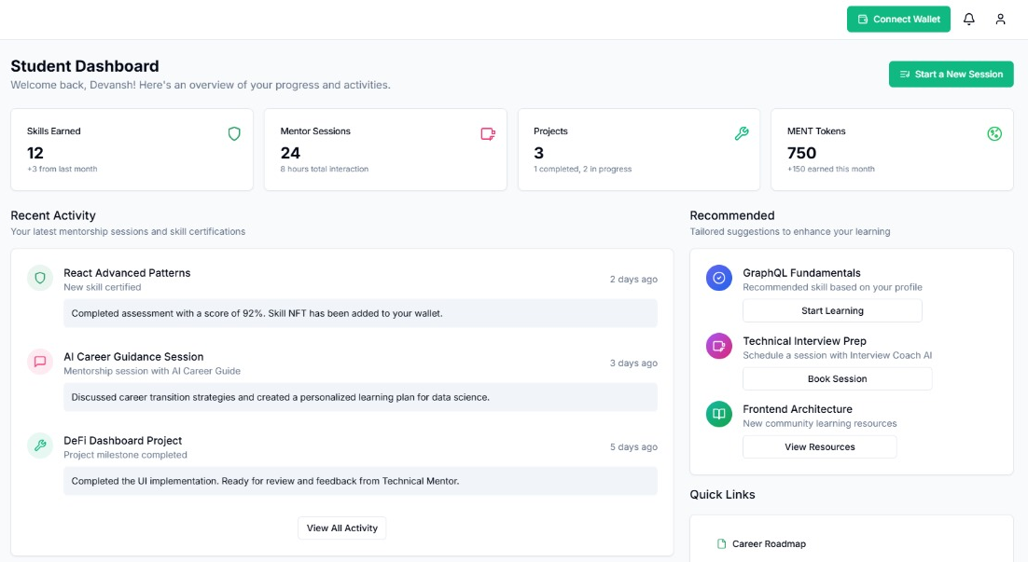
Implementation ScreenShots

Slide 27
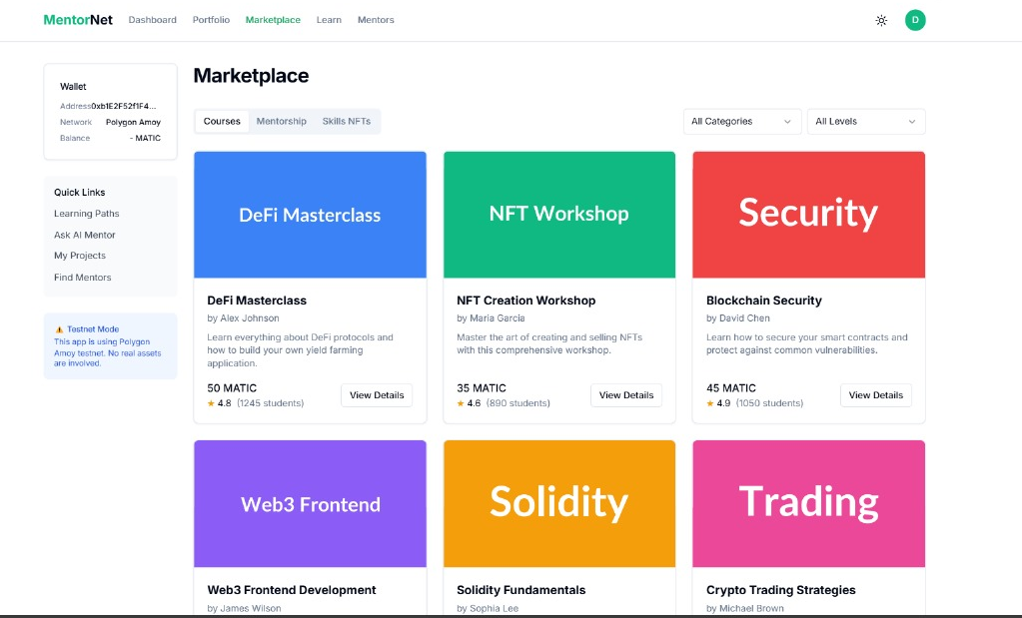
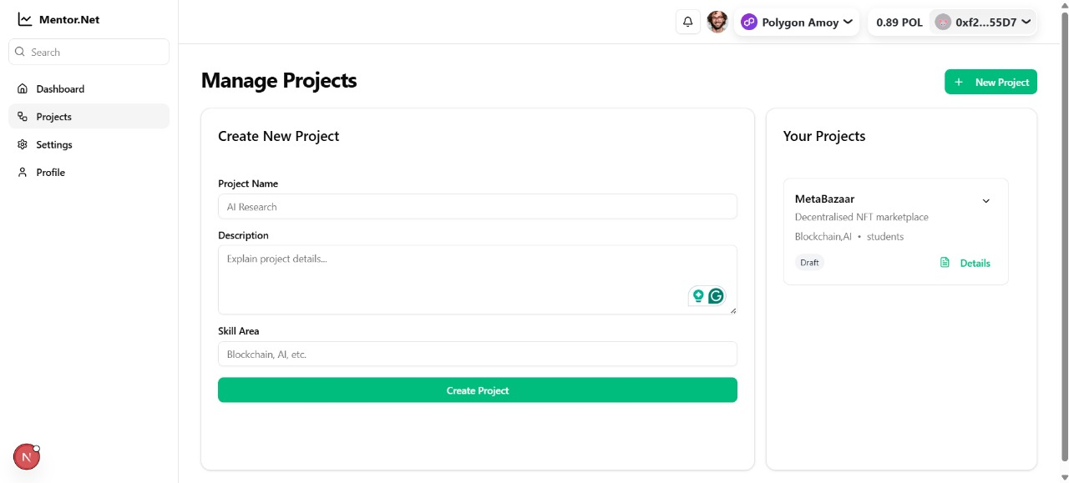
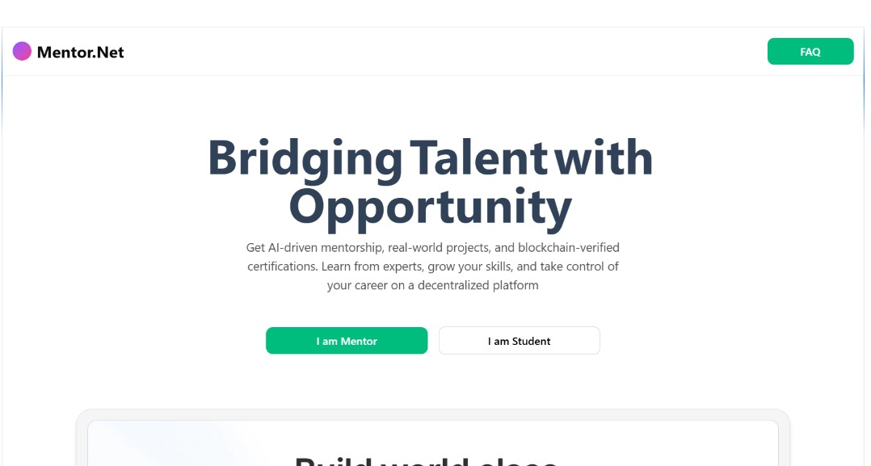
Implementation ScreenShots

Slide 28
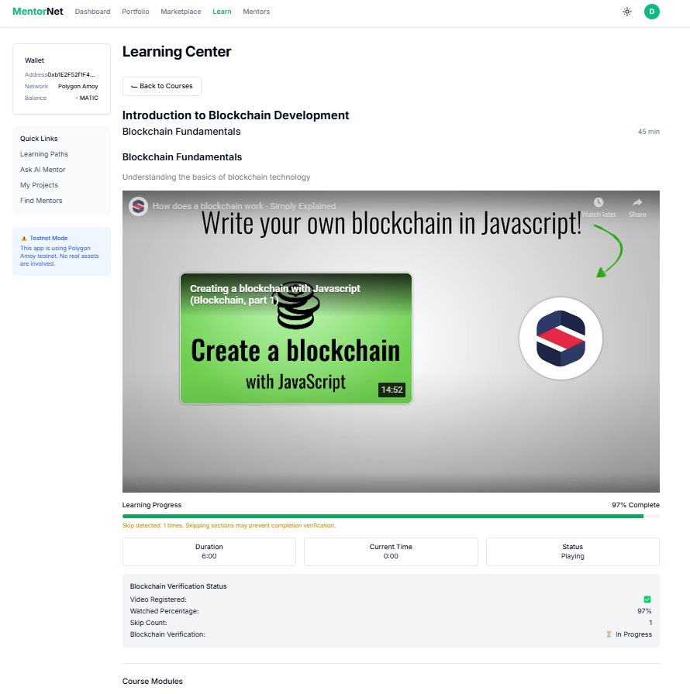
Implementation ScreenShots on Feedback Received

Slide 29
Future Objectives
AI-Powered Certification & Mentorship
Certification Issuance through Soulbound Tokens
What It Is ? :
Issues non-transferable NFT-based certificates for verified skills.
Authentic, tamper-proof and permanent proof of achievements is ensured.
How It Works ? :
Upon project completion, mentors validate skills.
Blockchain generates a Soulbound NFT. This is irrevocably attached to the student.
Impact :
Creates trustworthy, verifiable certifications.
Enhances employability with authentic skill proof.

Slide 30
Future Objectives
AI-Driven Mentor - Student Matching
What It Is ? :
Uses AI models to match students with mentors based on:
Skills, interests, and career goals.
Recommends personalized projects and learning paths.
How It Works ? :
AI analyzes student profiles and suggests suitable mentors.
Guarantees custom advice and pertinent project tasks.
Impact :
Provides personalized career support.
Improves mentorship effectiveness and student outcomes.

Slide 31
Future Objectives
Token-Based Incentives
What It Is ? :
Students and mentors earn tokens for milestones and contributions.
Rewards for project completion skill validation and mentoring.
How It Works ? :
Smart contracts automatically distribute tokens.
Tokens might be employed to gain some platform advantages or to boast about your reputation.
Impact :
Incentivizes consistent participation.
Encourages active mentoring and student engagement.

Slide 32
Future Objectives
Crypto Rewards for Mentors
What It Is ? :
Mentors get rewarded in crypto for validating projects.
Promotes quality mentorship through financial rewards.
How It Works ? :
Mentors receive DAO tokens for contributions.
Tokens can be staked or exchanged for rewards.
Impact :
Promotes mentor retention and quality.
Creates a sustainable, rewarding ecosystem.

Slide 33
Future Objectives
AI-Powered Industry Trend Analysis
What It Is ? :
Real-time insights into job market trends.
Guides students on in-demand skills.
How It Works ? :
AI mines information from industry reports and job boards.
Provides personalized career recommendations.
Impact :
Ensures students learn relevant skills.
Improves career readiness and decision-making.

